Slide 1
Dissected Parallelogram
From a puzzle from Brilliant.​

Slide 2
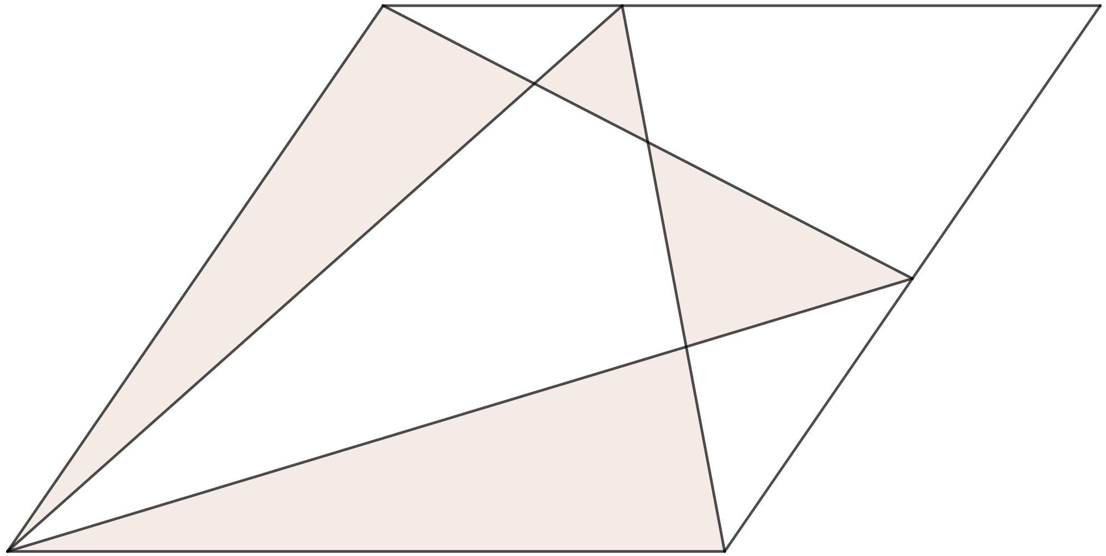






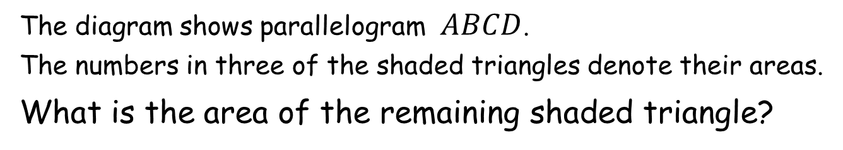

Dissected Parallelogram
$$D$$
$$C$$
$$48$$
$$21$$
$$63$$
$$A$$
$$B$$
The diagram shows parallelogram $ABCD$.
The numbers in three of the shaded triangles denote their areas.
What is the area of the remaining shaded triangle?
Notes:
The worksheet (48, 21, 63) is actually drawn to scale.

Slide 3
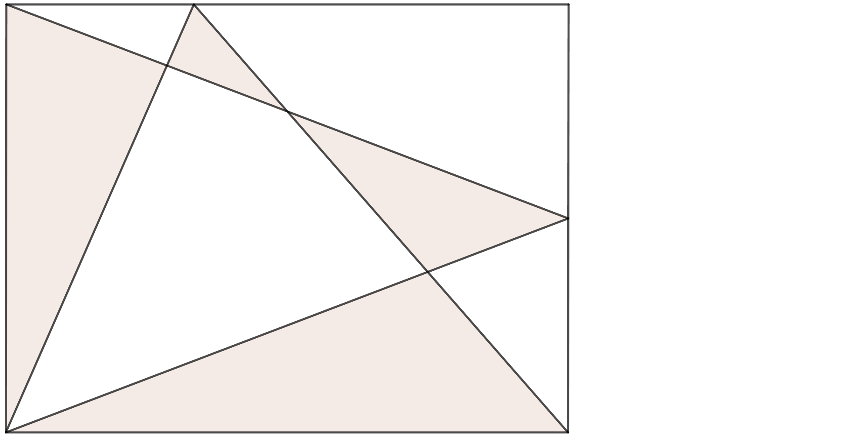






Dissected Parallelogram
$$D$$
$$C$$
$$48$$
$$21$$
$$63$$
Not drawn to scale
$$A$$
$$B$$
Transforming the parallelogram to a rectangle by sliding the top edge to the left changes the shape but none of the areas.
Nor does it change ratios of segment lengths.
A rectangle is a lot easier to analyse.

Slide 4


Dissected Parallelogram
$$D$$
$$F$$
$$C$$
$$48$$
$$21$$
$$E$$
$$63$$
Not drawn to scale
$$A$$
$$B$$
Let us label two points on the rectangle.
HINT: The area of a triangle is half that of its enveloping rectangle.

Slide 5
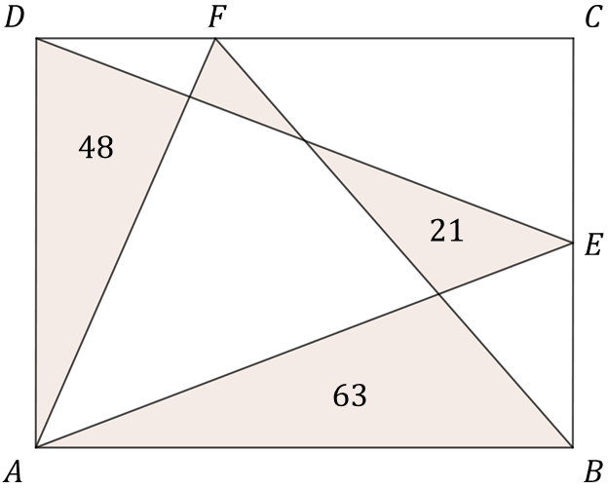
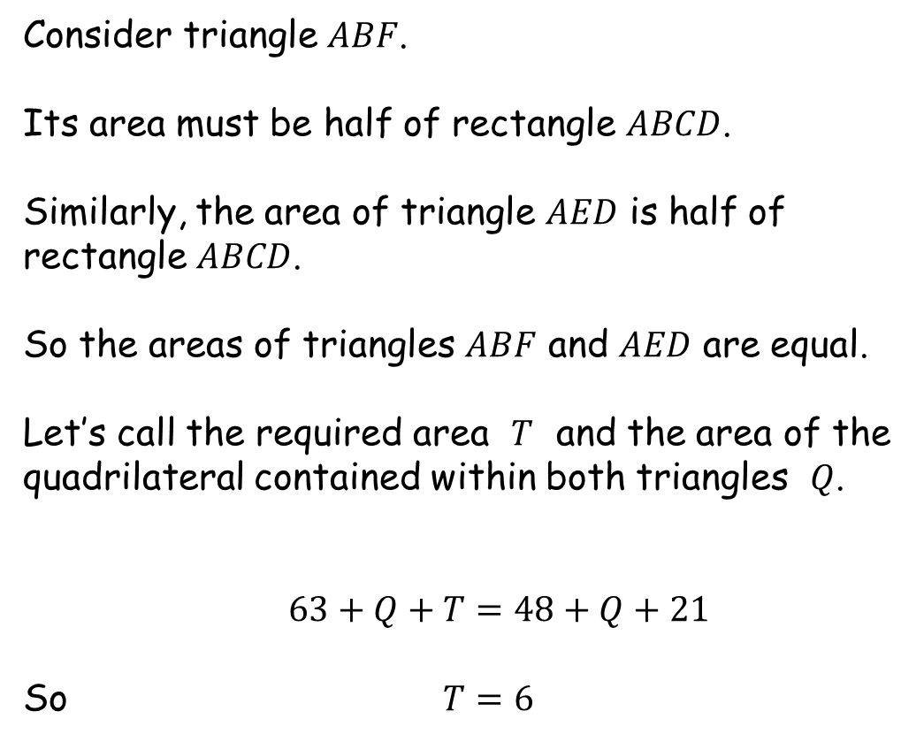


Dissected Parallelogram
$$T$$
Consider triangle $ABF$.
Its area must be half of rectangle $ABCD$.
Similarly, the area of triangle $AED$ is half of rectangle $ABCD$.
So the areas of triangles $ABF$ and $AED$ are equal.
Let’s call the required area $T$ and the area of the quadrilateral contained within both triangles $Q$.
$63+Q+T=48+Q+21$
So $T=6$
$$Q$$

Slide 6



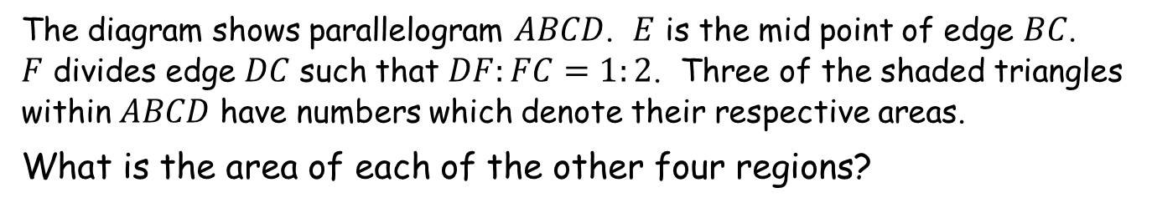

Dissected Parallelogram
SIC_72
$$D$$
$$F$$
$$C$$
Additional exercise
$$6$$
$$48$$
$$21$$
$$E$$
$$63$$
Not drawn to scale
$$A$$
$$B$$
The diagram shows parallelogram $ABCD$. $E$ is the mid point of edge $BC$.
$F$ divides edge $DC$ such that $DF:FC=1:2$. Three of the shaded triangles within $ABCD$ have numbers which denote their respective areas.
What is the area of each of the other four regions?
Notes:
The worksheet (48, 21, 63) is actually drawn to scale.

Slide 7

Dissected Parallelogram
$$D$$
$$F$$
$$C$$
$$6$$
$$48$$
$$21$$
$$E$$
$$63$$
Not drawn to scale
$$A$$
$$B$$
Let us transform it to a rectangle as before.

Slide 8
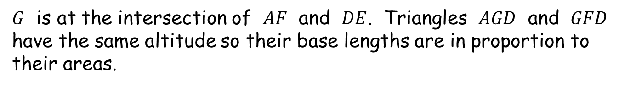









Dissected Parallelogram
$\frac{\frac{1}{3}−2a}{a}=\frac{\left(\frac{1}{3}\right)}{1}$
$1−6a=a$
$a=\frac{1}{7}$
$FG:GA=1:6$
$area FGD:area GAD=1:6$
$area FGD=8$
$$D$$
$$F$$
$$C$$
$$a$$
$$6$$
$$2a$$
$$G$$
$$48$$
$$21$$
$$E$$
$$63$$
$$A$$
$$B$$
Let us now transform it to a unit square.
$G$ is at the intersection of $AF$ and $DE$. Triangles $AGD$ and $GFD$ have the same altitude so their base lengths are in proportion to their areas.

Slide 9


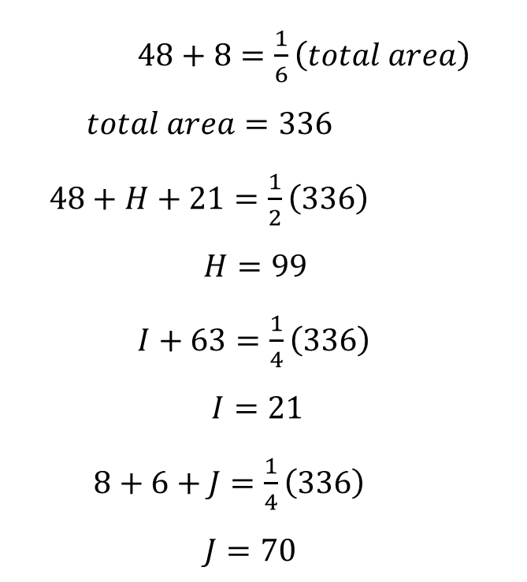





Dissected Parallelogram
$$D$$
$$F$$
$$C$$
$$8$$
$$6$$
$48+8=\frac{1}{6}\left(total area\right)$
$total area=336$
$48+H+21=\frac{1}{2}\left(336\right)$
$H=99$
$I+63=\frac{1}{4}\left(336\right)$
$I=21$
$8+6+J=\frac{1}{4}\left(336\right)$
$J=70$
$$J$$
$$70$$
$$48$$
$$21$$
$$E$$
$$H$$
$$99$$
$$I$$
$$21$$
$$63$$
$$A$$
$$B$$

Slide 10




Dissected Parallelogram
SIC_72
$$D$$
$$F$$
$$C$$
Additional exercise
$$8$$
$$6$$
$$70$$
$$48$$
$$21$$
$$E$$
$$99$$
$$21$$
$$63$$
Not drawn to scale
$$A$$
$$B$$
The diagram shows parallelogram $ABCD$. $E$ is the mid point of edge $BC$.
$F$ divides edge $DC$ such that $DF:FC=1:2$. Three of the shaded triangles within $ABCD$ have numbers which denote their respective areas.
What is the area of each of the other four regions?
Notes:
The worksheet (48, 21, 63) is actually drawn to scale.

Slide 12
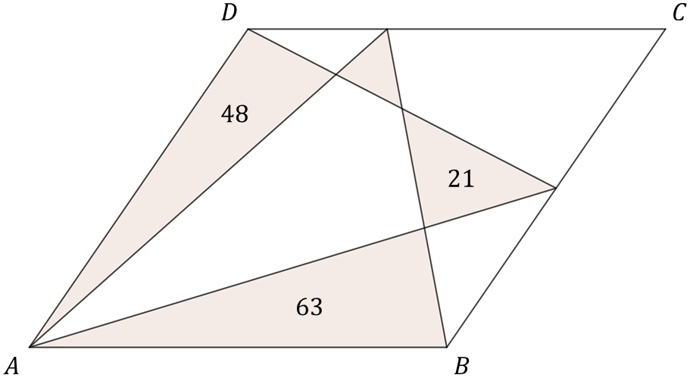





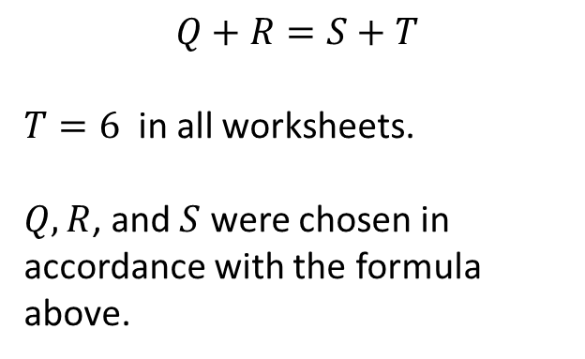
Note to Teacher
The answer is $6$ to all worksheets.
$$T$$
$$Q$$
$$R$$
$$Q+R=S+T$$
$T=6$ in all worksheets.
$Q, R$, and $S$ were chosen in accordance with the formula above.
$$S$$

Slide 13
Resources

Slide 14

Dissected Parallelogram
SIC_72
$$D$$
$$C$$
$$A$$
$$48$$
$$21$$
$$63$$
Not drawn to scale
$$A$$
$$B$$
The diagram shows parallelogram $ABCD$.
The numbers in three of the shaded triangles denote their areas.
What is the area of the remaining shaded triangle?
Notes:
The worksheet (48, 21, 63) is actually drawn to scale.

Slide 15



Dissected Parallelogram
SIC_72
$$D$$
$$C$$
$$B$$
$$45$$
$$21$$
$$60$$
Not drawn to scale
$$A$$
$$B$$
The diagram shows parallelogram $ABCD$.
The numbers in three of the shaded triangles denote their areas.
What is the area of the remaining shaded triangle?
Notes:
The worksheet (48, 21, 63) is actually drawn to scale.

Slide 16




Dissected Parallelogram
SIC_72
$$D$$
$$C$$
$$C$$
$$40$$
$$20$$
$$54$$
Not drawn to scale
$$A$$
$$B$$
The diagram shows parallelogram $ABCD$.
The numbers in three of the shaded triangles denote their areas.
What is the area of the remaining shaded triangle?
Notes:
The worksheet (48, 21, 63) is actually drawn to scale.

Slide 17



Dissected Parallelogram
SIC_72
$$D$$
$$C$$
$$D$$
$$40$$
$$30$$
$$64$$
Not drawn to scale
$$A$$
$$B$$
The diagram shows parallelogram $ABCD$.
The numbers in three of the shaded triangles denote their areas.
What is the area of the remaining shaded triangle?
Notes:
The worksheet (48, 21, 63) is actually drawn to scale.

Slide 18



Dissected Parallelogram
SIC_72
$$D$$
$$C$$
$$E$$
$$42$$
$$30$$
$$66$$
Not drawn to scale
$$A$$
$$B$$
The diagram shows parallelogram $ABCD$.
The numbers in three of the shaded triangles denote their areas.
What is the area of the remaining shaded triangle?
Notes:
The worksheet (48, 21, 63) is actually drawn to scale.

Slide 19



Dissected Parallelogram
SIC_72
$$D$$
$$C$$
$$F$$
$$44$$
$$30$$
$$68$$
Not drawn to scale
$$A$$
$$B$$
The diagram shows parallelogram $ABCD$.
The numbers in three of the shaded triangles denote their areas.
What is the area of the remaining shaded triangle?
Notes:
The worksheet (48, 21, 63) is actually drawn to scale.

Slide 20




Dissected Parallelogram
SIC_72
$$D$$
$$C$$
$$G$$
$$46$$
$$32$$
$$72$$
Not drawn to scale
$$A$$
$$B$$
The diagram shows parallelogram $ABCD$.
The numbers in three of the shaded triangles denote their areas.
What is the area of the remaining shaded triangle?
Notes:
The worksheet (48, 21, 63) is actually drawn to scale.

Slide 21


Dissected Parallelogram
SIC_72
$$D$$
$$C$$
$$H$$
$$44$$
$$32$$
$$70$$
Not drawn to scale
$$A$$
$$B$$
The diagram shows parallelogram $ABCD$.
The numbers in three of the shaded triangles denote their areas.
What is the area of the remaining shaded triangle?
Notes:
The worksheet (48, 21, 63) is actually drawn to scale.

Slide 22




Dissected Parallelogram
SIC_72
$$D$$
$$C$$
$$I$$
$$54$$
$$40$$
$$88$$
Not drawn to scale
$$A$$
$$B$$
The diagram shows parallelogram $ABCD$.
The numbers in three of the shaded triangles denote their areas.
What is the area of the remaining shaded triangle?
Notes:
The worksheet (48, 21, 63) is actually drawn to scale.

Slide 23



Dissected Parallelogram
SIC_72
$$D$$
$$C$$
$$J$$
$$52$$
$$24$$
$$70$$
Not drawn to scale
$$A$$
$$B$$
The diagram shows parallelogram $ABCD$.
The numbers in three of the shaded triangles denote their areas.
What is the area of the remaining shaded triangle?
Notes:
The worksheet (48, 21, 63) is actually drawn to scale.

Slide 24



Dissected Parallelogram
SIC_72
$$D$$
$$C$$
$$K$$
$$55$$
$$39$$
$$88$$
Not drawn to scale
$$A$$
$$B$$
The diagram shows parallelogram $ABCD$.
The numbers in three of the shaded triangles denote their areas.
What is the area of the remaining shaded triangle?
Notes:
The worksheet (48, 21, 63) is actually drawn to scale.

Slide 25



Dissected Parallelogram
SIC_72
$$D$$
$$C$$
$$L$$
$$38$$
$$30$$
$$62$$
Not drawn to scale
$$A$$
$$B$$
The diagram shows parallelogram $ABCD$.
The numbers in three of the shaded triangles denote their areas.
What is the area of the remaining shaded triangle?
Notes:
The worksheet (48, 21, 63) is actually drawn to scale.

Slide 26


Dissected Parallelogram
SIC_72
$$D$$
$$C$$
$$M$$
$$36$$
$$30$$
$$60$$
Not drawn to scale
$$A$$
$$B$$
The diagram shows parallelogram $ABCD$.
The numbers in three of the shaded triangles denote their areas.
What is the area of the remaining shaded triangle?
Notes:
The worksheet (48, 21, 63) is actually drawn to scale.

Slide 27



Dissected Parallelogram
SIC_72
$$D$$
$$C$$
$$N$$
$$35$$
$$25$$
$$54$$
Not drawn to scale
$$A$$
$$B$$
The diagram shows parallelogram $ABCD$.
The numbers in three of the shaded triangles denote their areas.
What is the area of the remaining shaded triangle?
Notes:
The worksheet (48, 21, 63) is actually drawn to scale.

Slide 28




Dissected Parallelogram
SIC_72
$$D$$
$$C$$
$$O$$
$$34$$
$$28$$
$$56$$
Not drawn to scale
$$A$$
$$B$$
The diagram shows parallelogram $ABCD$.
The numbers in three of the shaded triangles denote their areas.
What is the area of the remaining shaded triangle?
Notes:
The worksheet (48, 21, 63) is actually drawn to scale.

Slide 29




Dissected Parallelogram
SIC_72
$$D$$
$$C$$
$$P$$
$$39$$
$$13$$
$$46$$
Not drawn to scale
$$A$$
$$B$$
The diagram shows parallelogram $ABCD$.
The numbers in three of the shaded triangles denote their areas.
What is the area of the remaining shaded triangle?
Notes:
The worksheet (48, 21, 63) is actually drawn to scale.

Slide 30
Dissected Parallelogram
SIC_72
$$D$$
$$F$$
$$C$$
Additional exercise
$$6$$
$$48$$
$$21$$
$$E$$
$$63$$
Not drawn to scale
$$A$$
$$B$$
The diagram shows parallelogram $ABCD$. $E$ is the mid point of edge $BC$.
$F$ divides edge $DC$ such that $DF:FC=1:2$. Three of the shaded triangles within $ABCD$ have numbers which denote their respective areas.
What is the area of each of the other four regions?
Notes:
The worksheet (48, 21, 63) is actually drawn to scale.

Slide 31
Dissected Parallelogram
SIC_72
$$D$$
$$F$$
$$C$$
Additional exercise
$$6$$
$$48$$
$$21$$
$$E$$
$$63$$
Not drawn to scale
$$A$$
$$B$$
The diagram shows parallelogram $ABCD$. $E$ is the mid point of edge $BC$.
$F$ divides edge $DC$ such that $DF:FC=1:2$. Three of the shaded triangles within $ABCD$ have numbers which denote their respective areas.
What is the area of each of the other four regions?
Notes:
The worksheet (48, 21, 63) is actually drawn to scale.

Slide 32
Dissected Parallelogram
SIC_72
$$D$$
$$F$$
$$C$$
Additional exercise
$$6$$
$$48$$
$$21$$
$$E$$
$$63$$
Not drawn to scale
$$A$$
$$B$$
The diagram shows parallelogram $ABCD$. $E$ is the mid point of edge $BC$.
$F$ divides edge $DC$ such that $DF:FC=1:2$. Three of the shaded triangles within $ABCD$ have numbers which denote their respective areas.
What is the area of each of the other four regions?
Notes:
The worksheet (48, 21, 63) is actually drawn to scale.

Slide 33
Dissected Parallelogram
SIC_72
$$D$$
$$F$$
$$C$$
Additional exercise
$$6$$
$$48$$
$$21$$
$$E$$
$$63$$
Not drawn to scale
$$A$$
$$B$$
The diagram shows parallelogram $ABCD$. $E$ is the mid point of edge $BC$.
$F$ divides edge $DC$ such that $DF:FC=1:2$. Three of the shaded triangles within $ABCD$ have numbers which denote their respective areas.
What is the area of each of the other four regions?
Notes:
The worksheet (48, 21, 63) is actually drawn to scale.

